Slide 1

Bhilai Institute of Technology, Durg
Session: 2023 - 24
Exam Portal
Under the supervision of
Mr. Saurabh Singh
(Dept. of Computer Science)
Submitted To:
Mrs. Gargi Mishra
Mr. Sunil Nayak
Submitted By:
Miheer Gokhale
Neeraj Kumar

Slide 2
Introduction
The Online Exam Portal is a web-based application designed to facilitate the management and conduct of exams in an efficient and user-friendly manner.

Slide 3
Objective
Develop a reliable, secure, and user-friendly exam portal
Key Features:-
These portals streamline the entire examination process.
Offering numerous benefits such as increased efficiency, reduced paperwork.
Provide flexibility for both administrators and examinees.

Slide 4








Technologies Used
Frontend:
Backend:
Database:

Slide 5
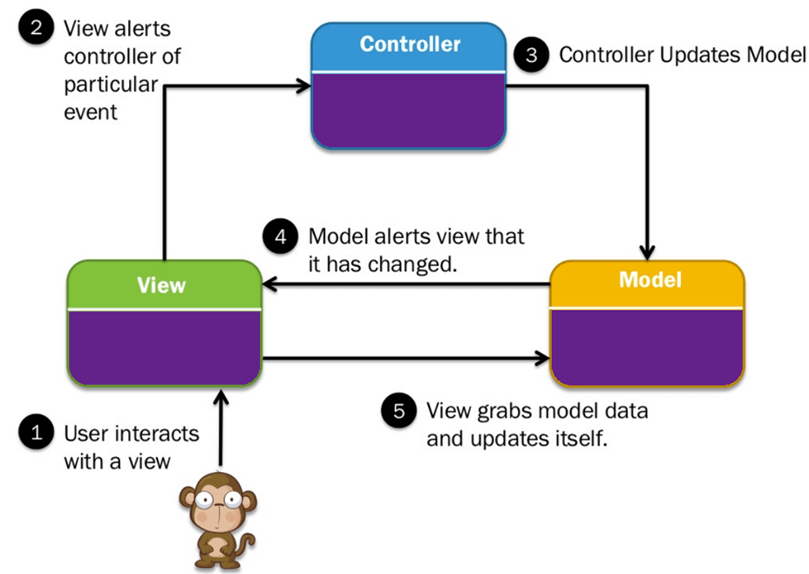
Methodology

Slide 6
Working
http://localhost:4200/

Slide 7


Login procedure

Slide 8
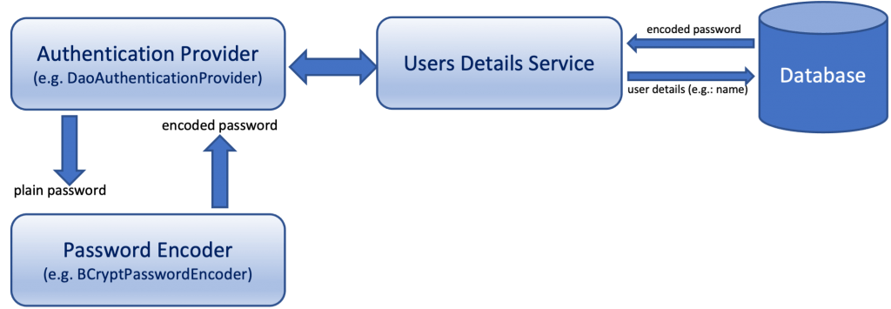
Login procedure
Eg. Select password from user_table
where name = “neeraj kumar”;

Slide 9


Future Scope
Security
(Web Cam)
Video Solutions
Assessment
Cross-Institutional Collaboration

Slide 10

Thank You!

